Slide 1
EUSEM Working Conditions Project

Slide 2
EDs are demanding working environments
Working conditions affect health of
Providers
Patients
Negative working conditions result in stress related diseases and high provider drop out rate

Slide 3
General purpose of the survey
To identify general and local key issues of current ED work which affects ED provider well being
To identify context and process issues of successful interventions to improve working conditions

Slide 4
Research Questions
What is the current state of provider working conditions and well being in Eds across European states?
Are there any specific national solutions or suggestions for intervention and improvement approaches for ED working conditions and provider well being?
Which success factors can be identified to improve ED´s working conditions and provider well being

Slide 5
Specific questions
To gather and evaluate best practice solutions for working conditions improvement
To correlate working conditions with the organisation of the EMC and ED organization
To collect data on working conditions in different European countries
To identify specific challenges in ED working conditions
To identify specific and general factors which affect working conditions

Slide 6
Methods
Semi-structured expert video interviews with a total purposive convenience sample of around 12-18 subject matter experts, equally selected from various EUSEM member states (2-3 each).
Inclusion criteria:
Hospital-based ED consultant doctors and heads of emergency departments
Profound experience, expertise, theoretical and practical knowledge of hospital-based emergency medicine
Sufficient oral and written English language skills
Equal panel distribution between university, urban and rural hospitals

Slide 7
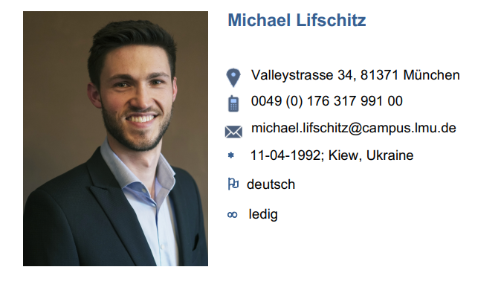
Methods
Semistructured interview on items known from the literature to affect provider working conditions
These telephone interviews are transcribed and analysed in a structured way

Slide 8
Next steps Call for experts of various nations from: Tertiary centers Medium size hospitals (200 – 600 beds) Small hospitals

Slide 9
Expression of interest:
Christoph.dodt@muenchen-klinik.de
Willemijnvh@eusem.org
After expression of interest an information package will be send with further information and an extensive reference list.
In case an interview is scheduled a date for a telephone interview will be fixed and the interview will be conducted (appr. 1,5 h duration)

